Slide 1
Going from local to generalizable: The role of implementation science to improve learning from QI
Lisa Hirschhorn, MD MPH
Professor Medical Social Sciences and Psychiatry and Behavioral Science
Northwestern University Feinberg School of Medicine
Senior Director Implementation and Improvement Science
Last Mile Health
www.cepim.northwestern.edu
www.bridges.northwestern.edu

Slide 2
Poor quality kills
5 million deaths are due to poor quality among people using care; 3.6 million from lack of access
Preventable
7.0m
Notes:
Among the 8.6 million deaths, 5.0 are among people who did seek care but received poor quality. The other 3.6 million are among people who did not seek care.

Slide 3
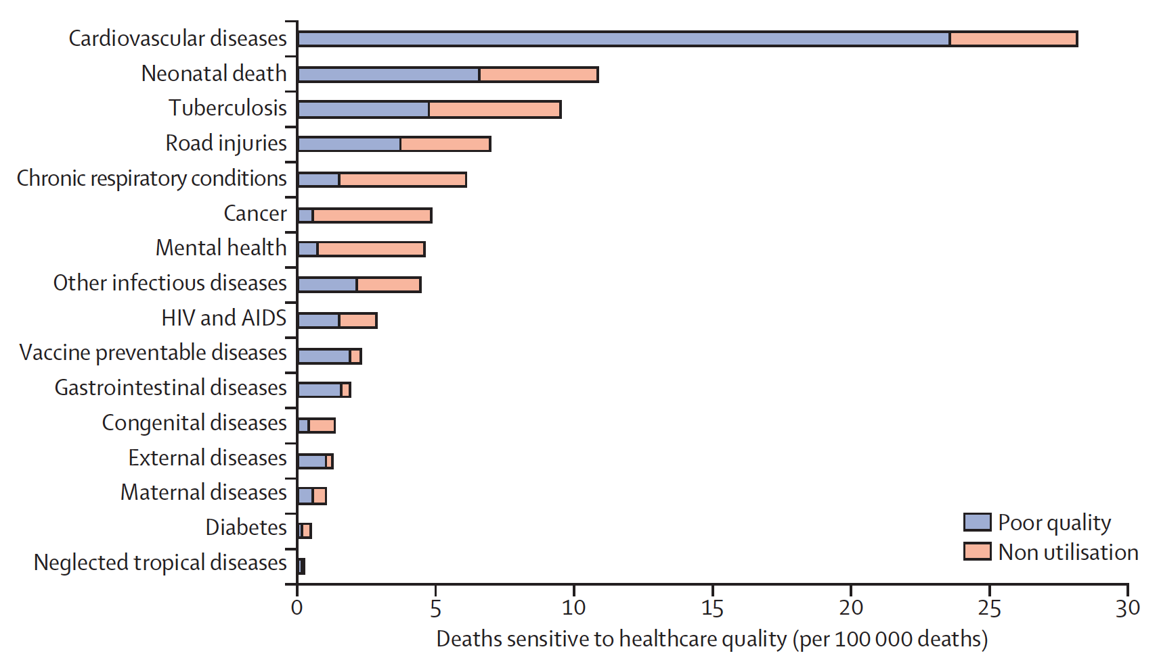
Quality plays a major role across conditions including HIV/AIDS
Scale without quality will never achieve the goals of ending the epidemic
Notes:
External factors deaths are those due to poisonings and adverse medical events. Other infectious diseases deaths are those due to diarrheal diseases, intestinal infections, respiratory infections and malaria.

Slide 4
Impact of much of how we traditionally try to improve is modest at best
But combinations can work better, but how?
Rowe et al. Lancet Global Health
Notes:
QI traditionally focuses on creating local change and local knowledge
Measures are often technical quality process
Lancet Commission of Quality noted need to accelerate and change to include broader system change, better education and governance/policy, and ignite demand
But need to create actionable knowledge for spread
These are ideal targets for implementation research of QI and to improve QI

Slide 5
Need for Implementation Research for QI and overlap with Improvement Science
QI traditionally has focused on creating local change and local knowledge
Measures are often technical quality process
Need to include improving systems at higher levels, management, governance and planning for sustainability at local and national levels
Ideal role for implementation research of QI and to improve QI (also known as/overlaps with Improvement Science)
Goals
Generate local wisdom and generalizable or transferable knowledge, using robust, well established research methods applied in highly pragmatic ways.
Enable local improvement and produce knowledge with external validity
Requires partnership, includes commitment to ethics around improvement
Marshall, Pronovost and Dixon-Wood, Lancet 2013)
Notes:
Lancet Commission of Quality noted need to accelerate and change to include broader system change, better education and governance/policy, and ignite demand
But need to create actionable knowledge for spread

Slide 6
Using Collaboratives to improve 90-90-90 while deepening implementation learning and creating generalizable knowledge
Strategy: Improvement Collaborative to increase 90-90-90 focuses on last 2
same day ART
retention and suppression
In Namibia and Zimbabwe
https://healthqual.ucsf.edu/

Slide 7
Using IS to help learn beyond effectiveness to inform future IC design
EPIS framework (Aarons et al) to understand initially planning, adaptation
Implementation strategies and outcomes across the components
coaching, QI, performance measurement, peer- learning
CFIR to capture key facilitators and barriers and drivers of adaptation/strategy choice

Slide 8
Examples of emerging knowledge. across Improvement Collaboratives
Use of coach/mentors (S) Building on Existing coach-site relationship and cpach capacity (C/S) | Acceptability Adoption | “The mentors already had existing relationships with sites. This facilitated them in asking sites to do more.” [KI] All sites were deeply engaged and reported mentors as important sources of support [Field notes LS]
Leveraging National and other stakeholder QI culture (C) National Leadership engagement (S) Alignment with national priorities (S) | Acceptability (+) | Even though some had QI-this was a “new thing” so goal was bringing together and focusing on only one thing” -facility and staff were really excited and grateful [KI8] “Key was harmonizing with the 90-90-90.. they saw the target.. and that the initiative would move forward towards that” [KI8]
Shared successful strategies included leadership engagement during exploration and preparation and throughout, leveraging existing QI capacity and coaches and strong focus on QI and PM coaching, alignment with national priorities
Different Contextual challenges included geography, resources, data quality required different adaptations

Slide 9
So what do we need to do?
Embed implementation research into improvement work to create generalizable and context specific knowledge
Build capacity and demand for improving how we improve
QI implementers and implementation researchers need to find the common language to learn with and from each other to address the gaps in quality and implementation needed to help end the epidemic

